Slide 1
Evolution
EPFL Software Engineering

Slide 2


Neuschwanstein Castle (Wikipedia)

Slide 3
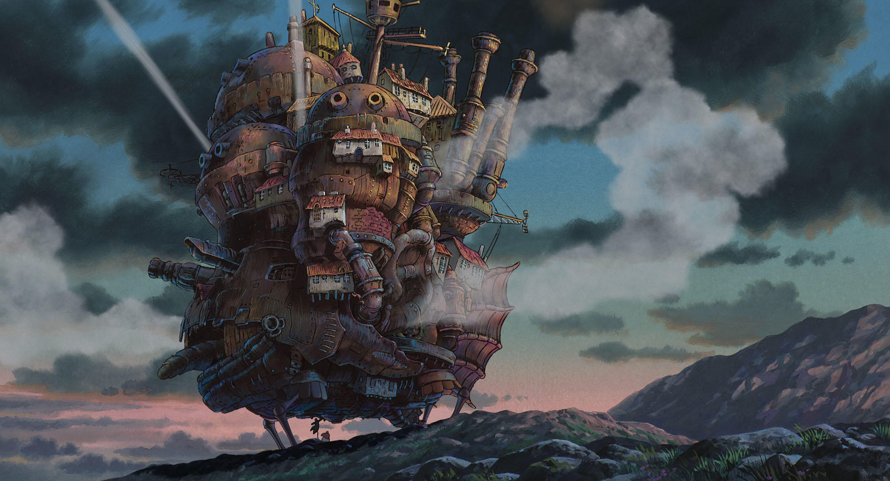
ghibli.jp/works/howl

Slide 4
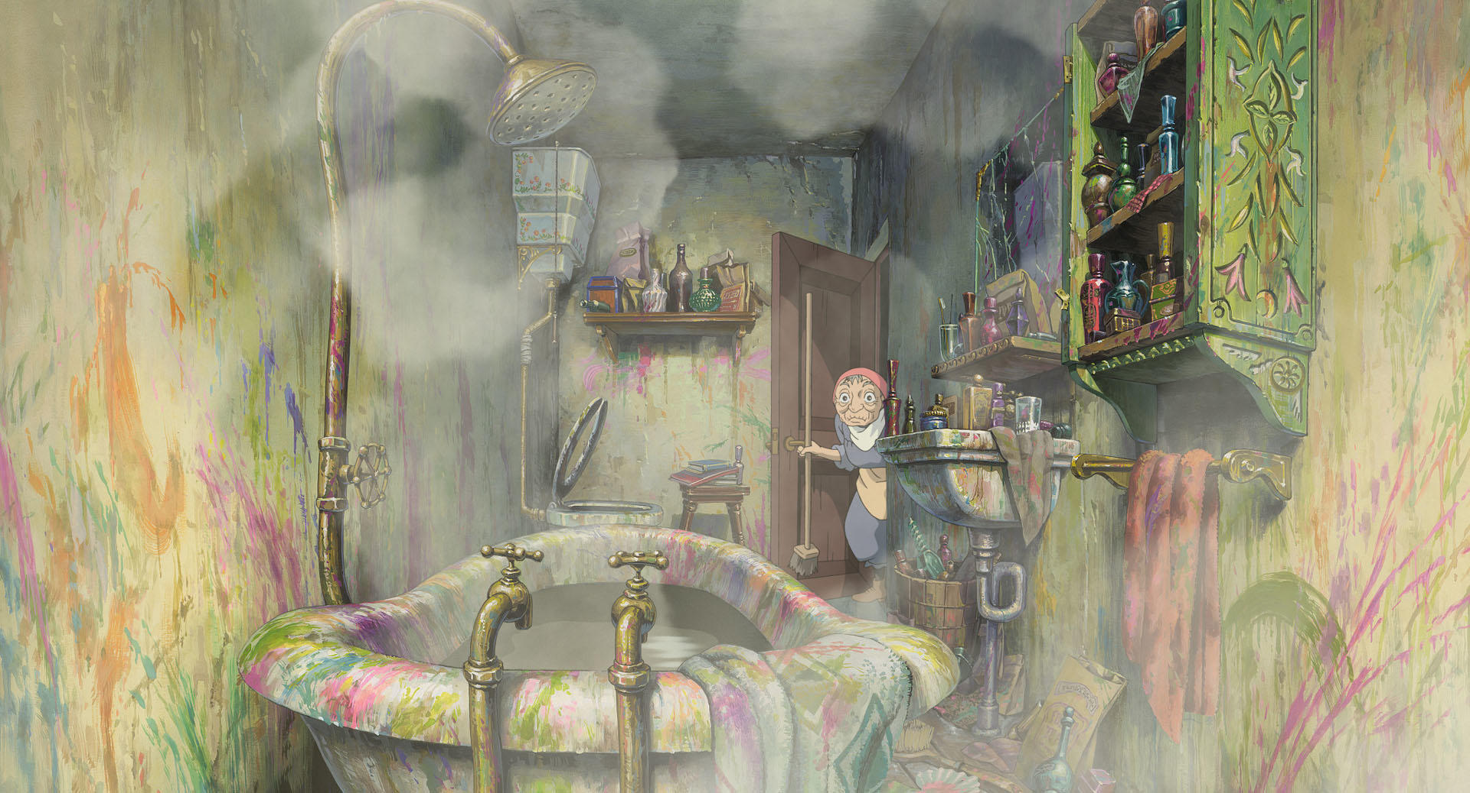
ghibli.jp/works/howl

Slide 5
Objectives
Find your way in a legacy codebase
Apply common refactorings to improve code
Document and quantify changes
Establish solid foundations with versioning

Slide 6
What is legacy code, and why should we care?

Slide 7
“Legacy” code
= “old”
With or without docs, tests, bugs…

Slide 8
Frequent reactions
“It’s ugly”
“It’s buggy”
“Why keep it?”

Slide 9
Rewrite?
Simpler!
Motivating!
Shiny new tech!

Slide 10
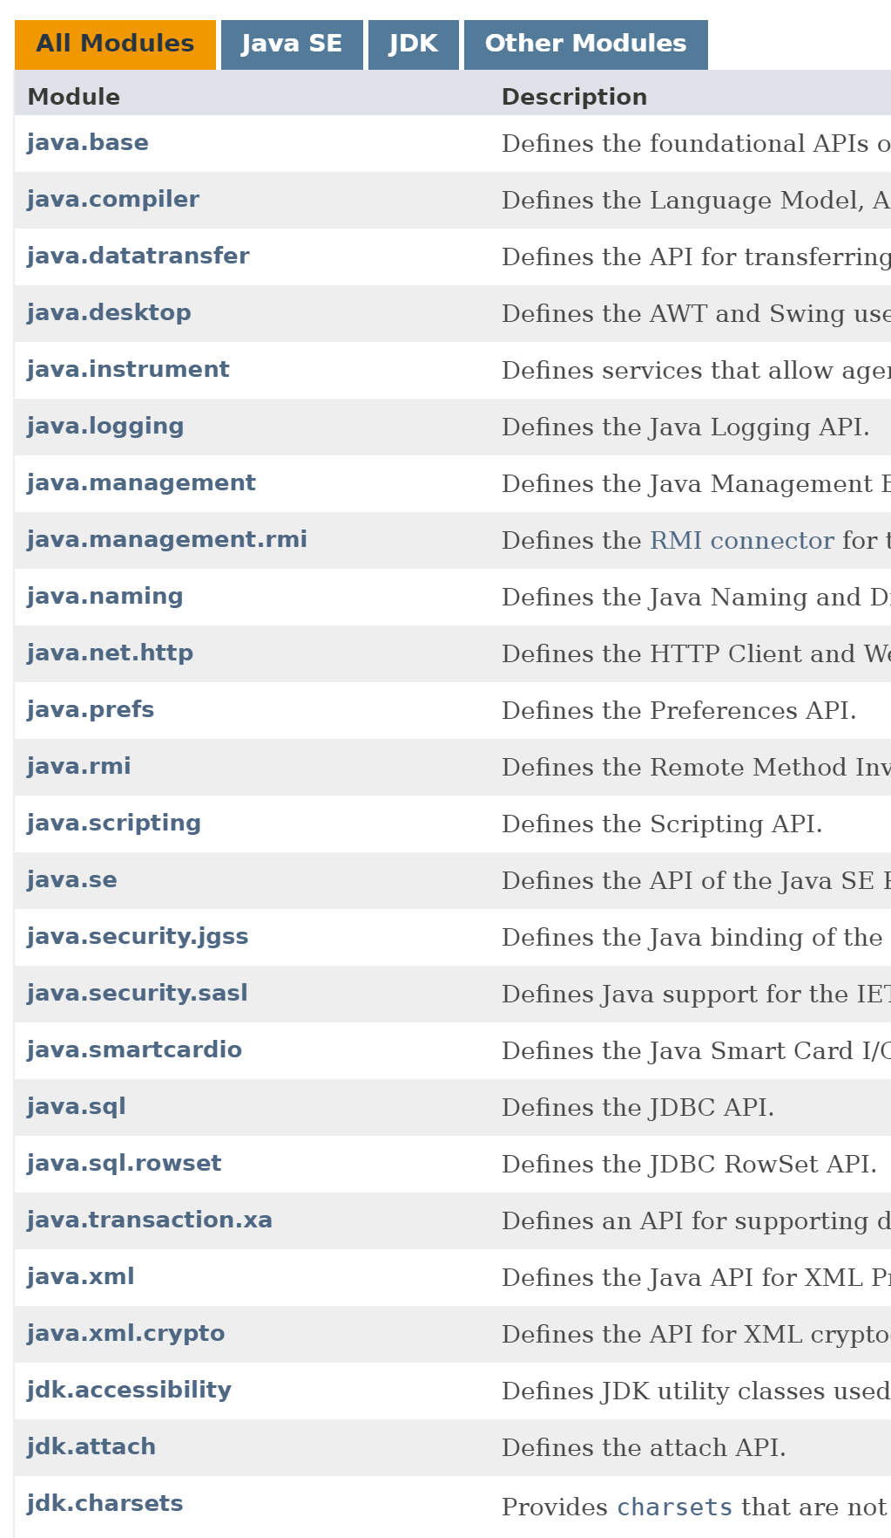
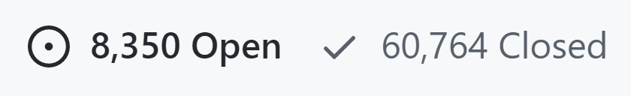
But…

Slide 11
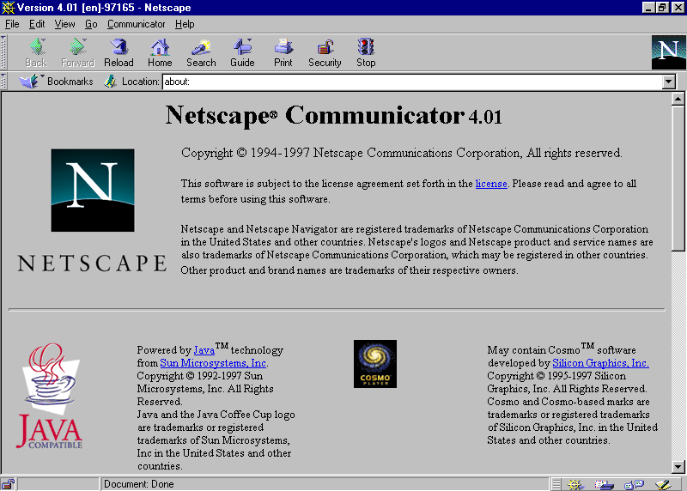

Slide 12




Rewrites lose…
Experience
Fixes
Time

Slide 13
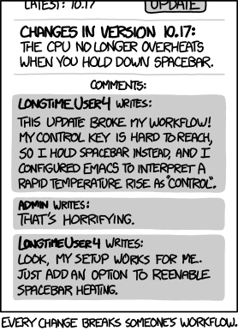
What is even a bug?
https://xkcd.com/1172/

Slide 14
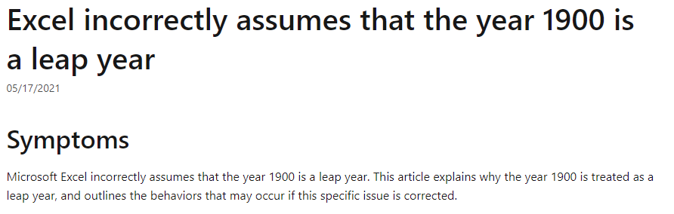
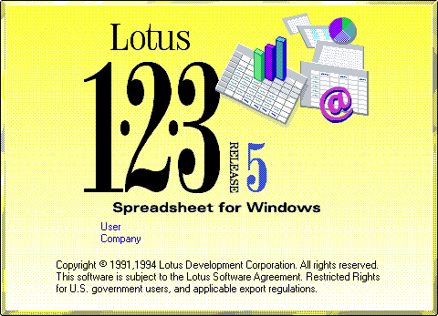
https://learn.microsoft.com/en-us/office/troubleshoot/excel/wrongly-assumes-1900-is-leap-year

Slide 15
Healthy reaction to legacy code
It’s your code now, accept responsibility

Slide 16
How can we improve legacy code?

Slide 17
Changes
Choose different tradeoffs
Address “technical debt”
“Refactor” code

Slide 18
Tradeoffs
Performance
Memory use
Complexity
Dependability
…

Slide 19
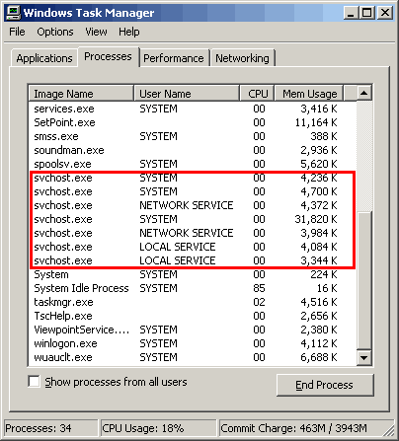
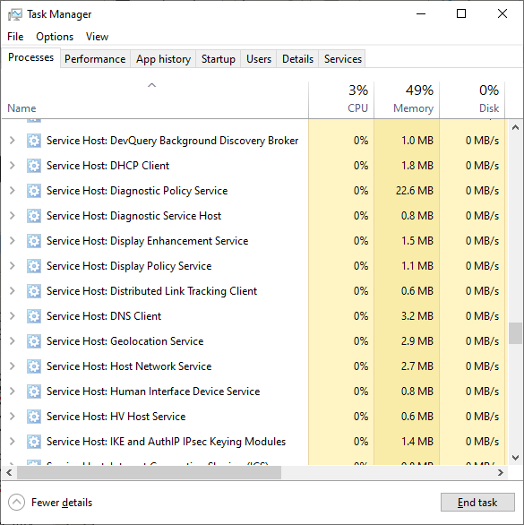
Windows XP, 2001
Windows 10, 2015

Slide 20



“Technical debt”

Slide 21
Debt

Slide 24
“Technical debt”
Pay it regularly!

Slide 25


Paying debt

Slide 26
Using standards

Slide 27
“Refactoring”
Incremental, internal improvement

Slide 33
Refactoring
Known problem
+
Known refactoring
=
Cleaner code

Slide 34
“Code smells”

Slide 35
Smell
class Player {
int hitPoints;
String weaponName;
int weaponDamage;
boolean isWeaponRanged;
}

Slide 36
“Extract class”
class Player {
int hitPoints;
Weapon weapon;
}

Slide 37
Smell
class Weapon {
boolean isRanged;
void attack() {
if (isRanged) { ... } else { ... }
}
}

Slide 38
“Use polymorphism”
abstract class Weapon {
abstract void attack();
}
class MeleeWeapon extends Weapon { ... }
class RangedWeapon extends Weapon { ... }

Slide 39
Smell
int damage() {
return level * attack - max(0, armor - 500) * attack / 20 + min(weakness * level / 10, 400);
}

Slide 40
“Extract variables”
int damage() {
int base = level * attack;
int resistance = ...;
int bonus = ...;
return base – resistance + bonus; }

Slide 41
Exercise
Look at gilded-rose/
First step: What is the code trying to do? What problems does it have?
Notes:
3min til next

Slide 42
Gilded Rose
Model the quality of items over time
But… special cases and copy/paste!
Next step: How would you improve it?
Notes:
3min

Slide 43
Refactor
for (int i = 0; i < items.length; i++)
for (Item item : items)

Slide 44
Simplify
item.quality = item.quality - item.quality;
item.quality = 0;

Slide 45
Extract Method
if (item.quality < 50)
item.quality = item.quality + 1;
item.incrementQuality();

Slide 46
Extract Constant
item.quality < 50
item.quality < MAX_QUALITY

Slide 47
Extract Method
item.name.equals(...)
item.isPerishable()

Slide 48
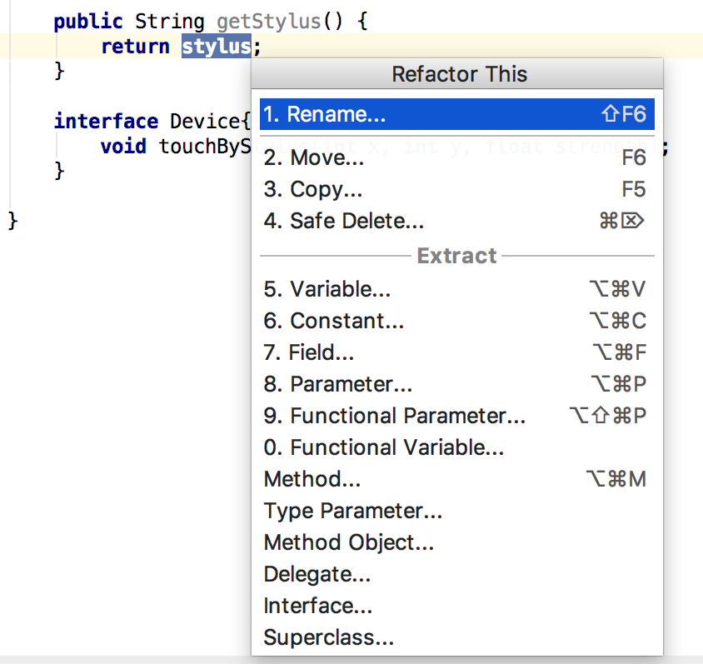
In your IDE

Slide 49
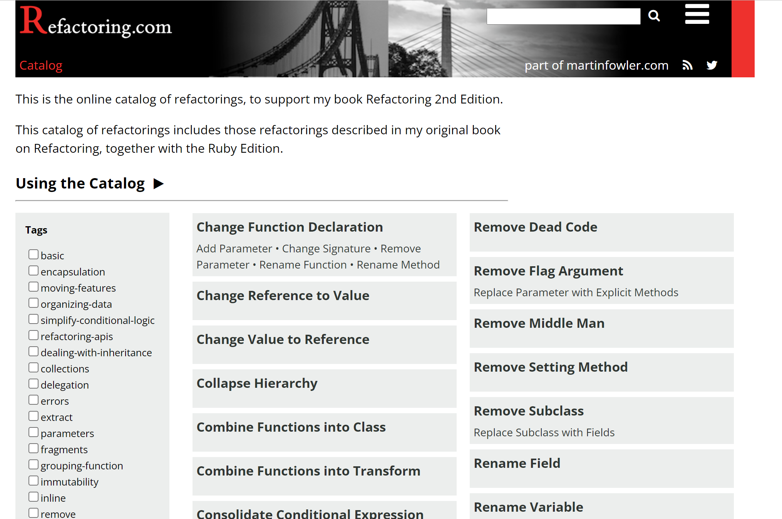
https://refactoring.com/catalog/

Slide 50
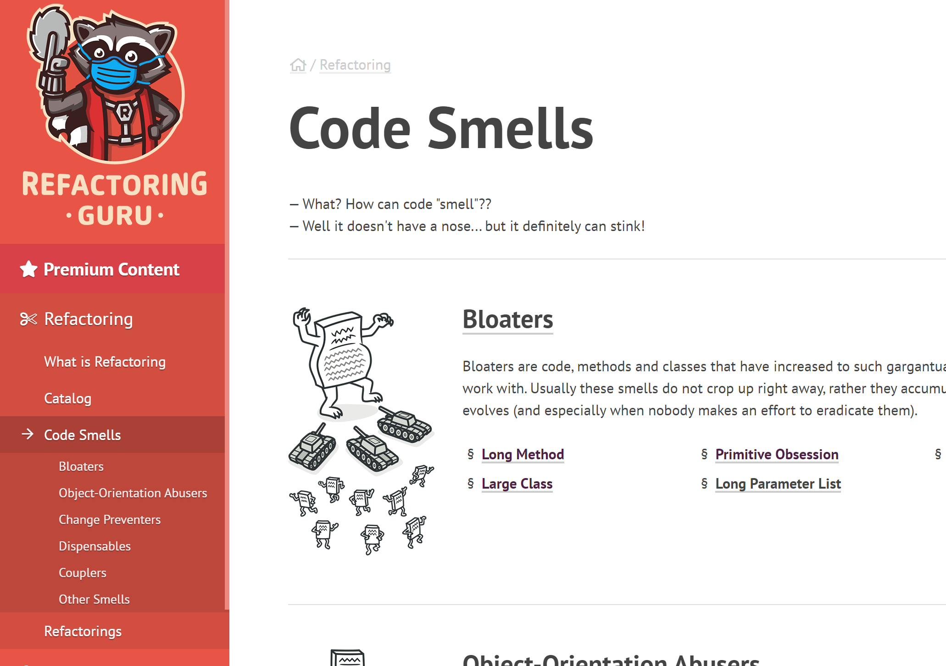
https://refactoring.guru/refactoring/smells

Slide 51
Where to start in a large codebase?

Slide 52
“Large”
100,000 – 100,000,000 lines of code
May not have documentation

Slide 53
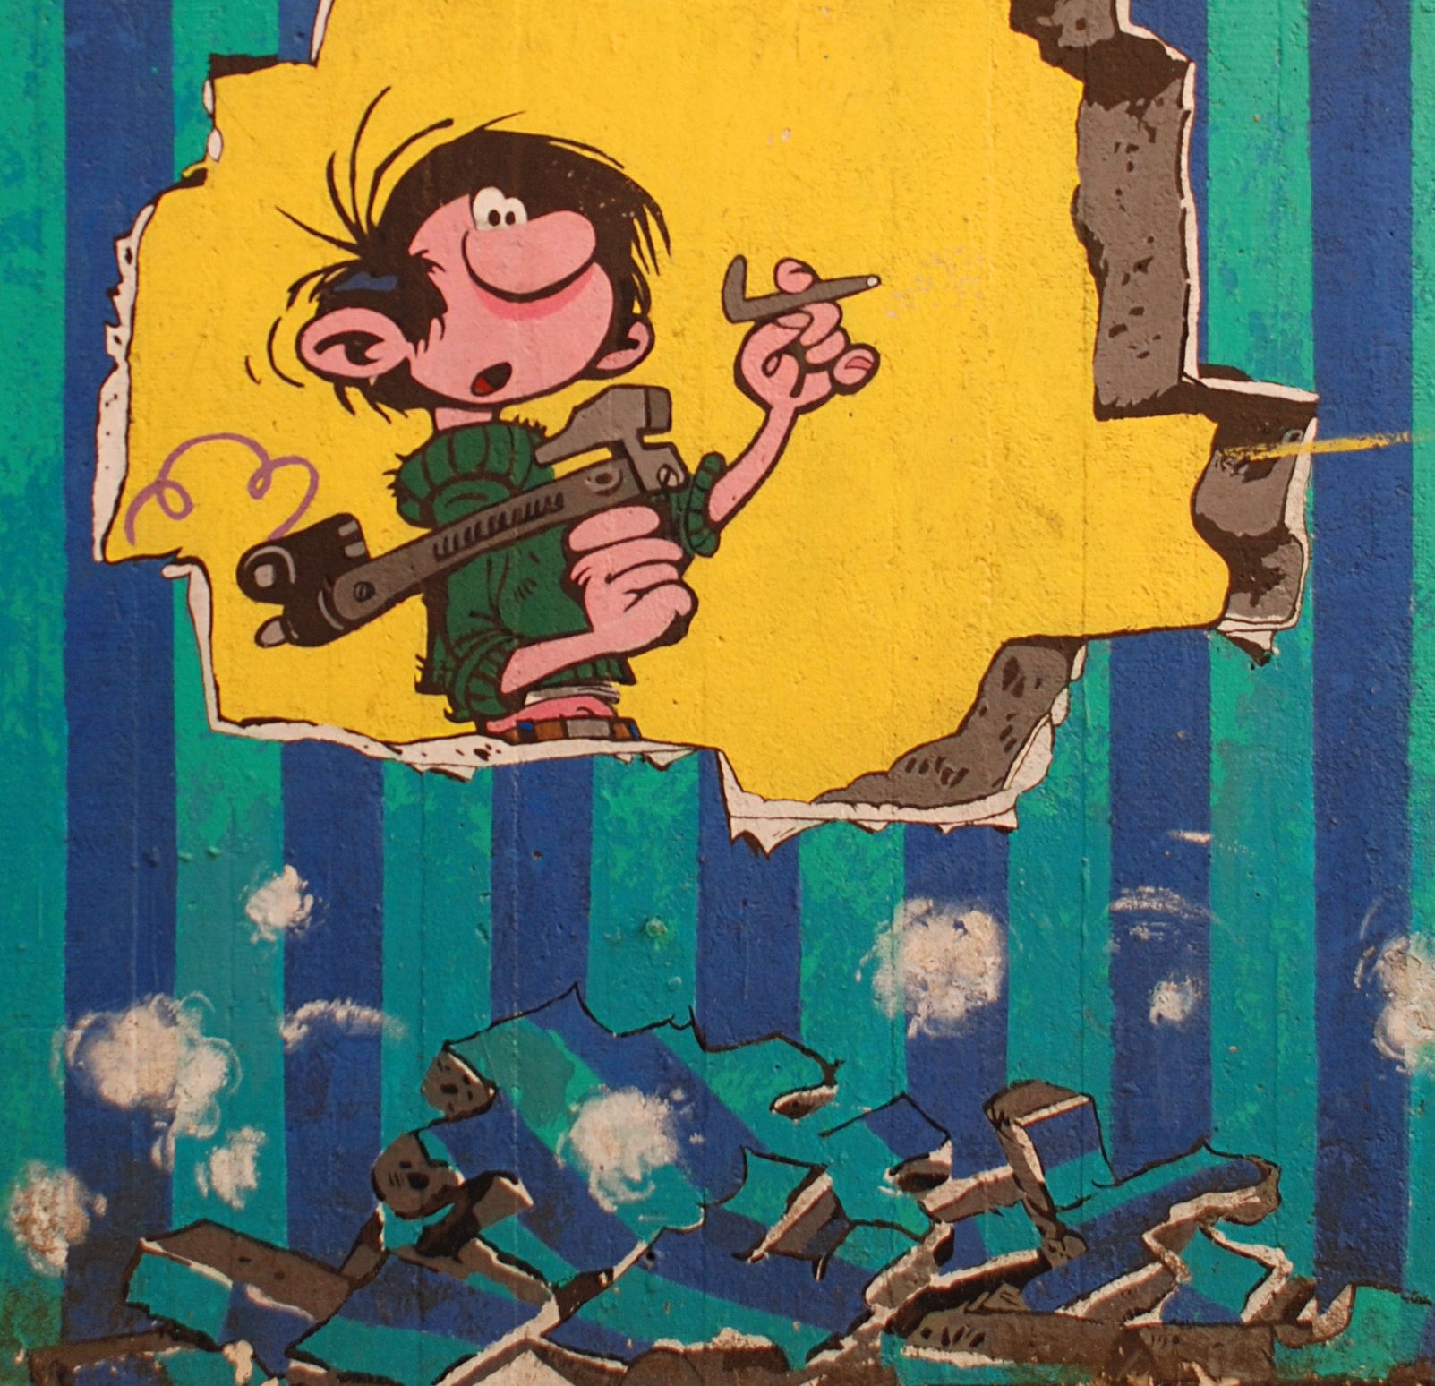
Naïve strategy
“Move fast, break things”
Belgique, Louvain-la-Neuve wall painting (Wikipedia)

Slide 54

Optimistic strategy
Understand everything

Slide 55
Realistic strategy
Learn as you go
Use an IDE
Take notes

Slide 56

Learn as you go

Slide 57
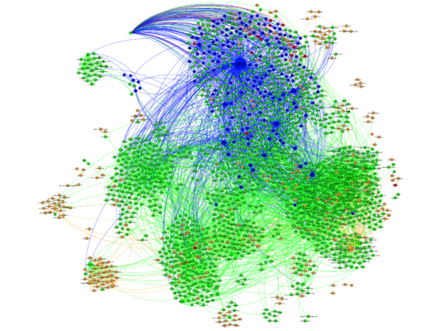

https://www.toofishes.net/blog/arch-package-visualization/

Slide 58
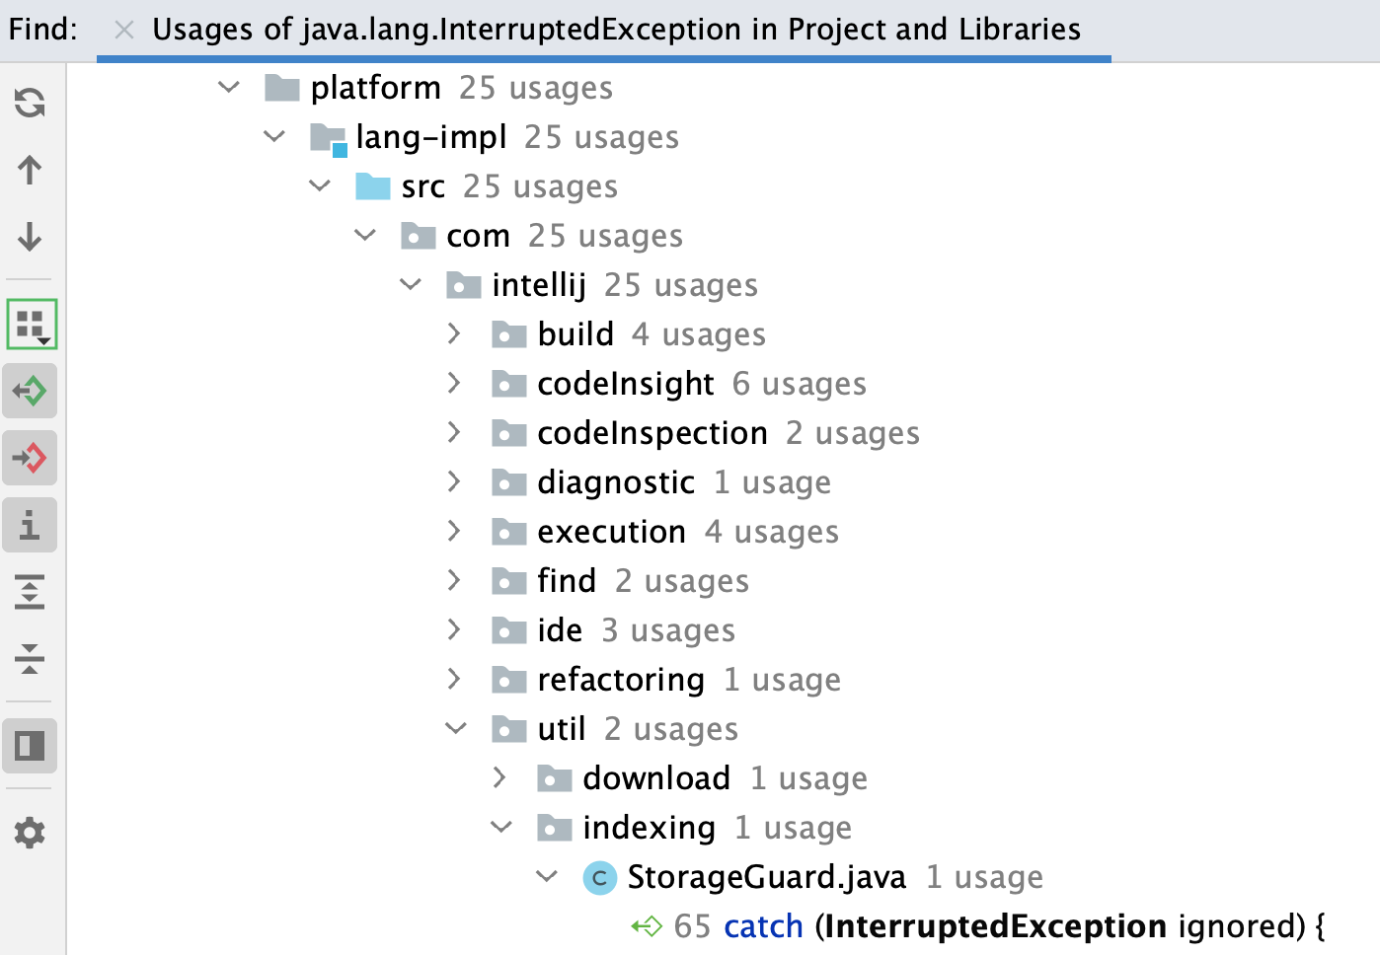
Use an IDE
https://www.jetbrains.com/help/idea/find-highlight-usages.html

Slide 59
IDE refactorings
boolean b;
Rename…

Slide 60
IDE debugger
Breakpoint in main()
Step, step, step…

Slide 61

Take notes

Slide 62
Regression tests
Write a test without assertions
Look at the result
Add assertions

Slide 63
“Facades”
Adapter from complex to simpler code

Slide 64
Facade example
var points = new Point[] {
new Point(0, 0), new Point(x, 0),
new Point(x, y), new Point(0, y)
};
draw(points, true, false, Color.RED, null, new Logger(), ...);

Slide 65
drawRectangle(0, 0, x, y, Color.RED);

Slide 66
Exercise
Open pacman/
First step: Look at the code Take notes!
Notes:
4min til next

Slide 67
Next step
Use a debugger to inspect the code’s flow
Notes:
4min til next

Slide 68
Next step
What needs changing to add a kind of ghost?
Notes:
4min til next

Slide 69
Modifications
enum ghostType { ... }
class ... extends Ghost { ... }
Parsing in MapEditor
ghostType ⬄ Ghost in PacBoard

Slide 70
Finally
How to make adding a kind of ghost easier?
Notes:
4min

Slide 71
Refactorings
Naming, formatting, …
De-duplicate ghost enum + class
Split parsing from MapEditor

Slide 72
“Scout rule”
Leave the code cleaner than you found it

Slide 73
365 days
3778%
3%

Slide 74
How should we document changes?

Slide 75

Rosetta Stone, Wikipedia

Slide 76
Documenting changes for…
Yourself
Reviewers
Maintainers

Slide 77
Documenting for yourself
Learn by teaching
“Refactor” comments and documentation

Slide 78
Example
// The server refuses values above 127
if (i > 127) i = 127;

Slide 79
/** ...
Also finds tabs.
Clients depend on this buggy behavior.
*/
int indexOfSpace(String text) { ... }

Slide 80
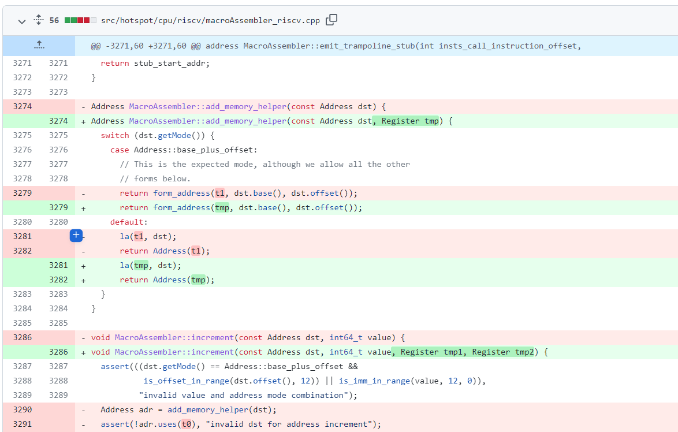
Documenting for reviewers
https://github.com/openjdk/jdk/pull/11005

Slide 81
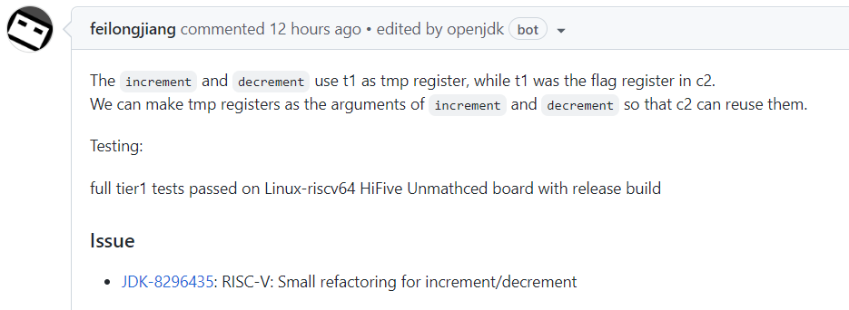
https://github.com/openjdk/jdk/pull/11005

Slide 82
Commits
Everything
Refactor
Move func.
Bug fix
Bug fix
Cleanup
…

Slide 83
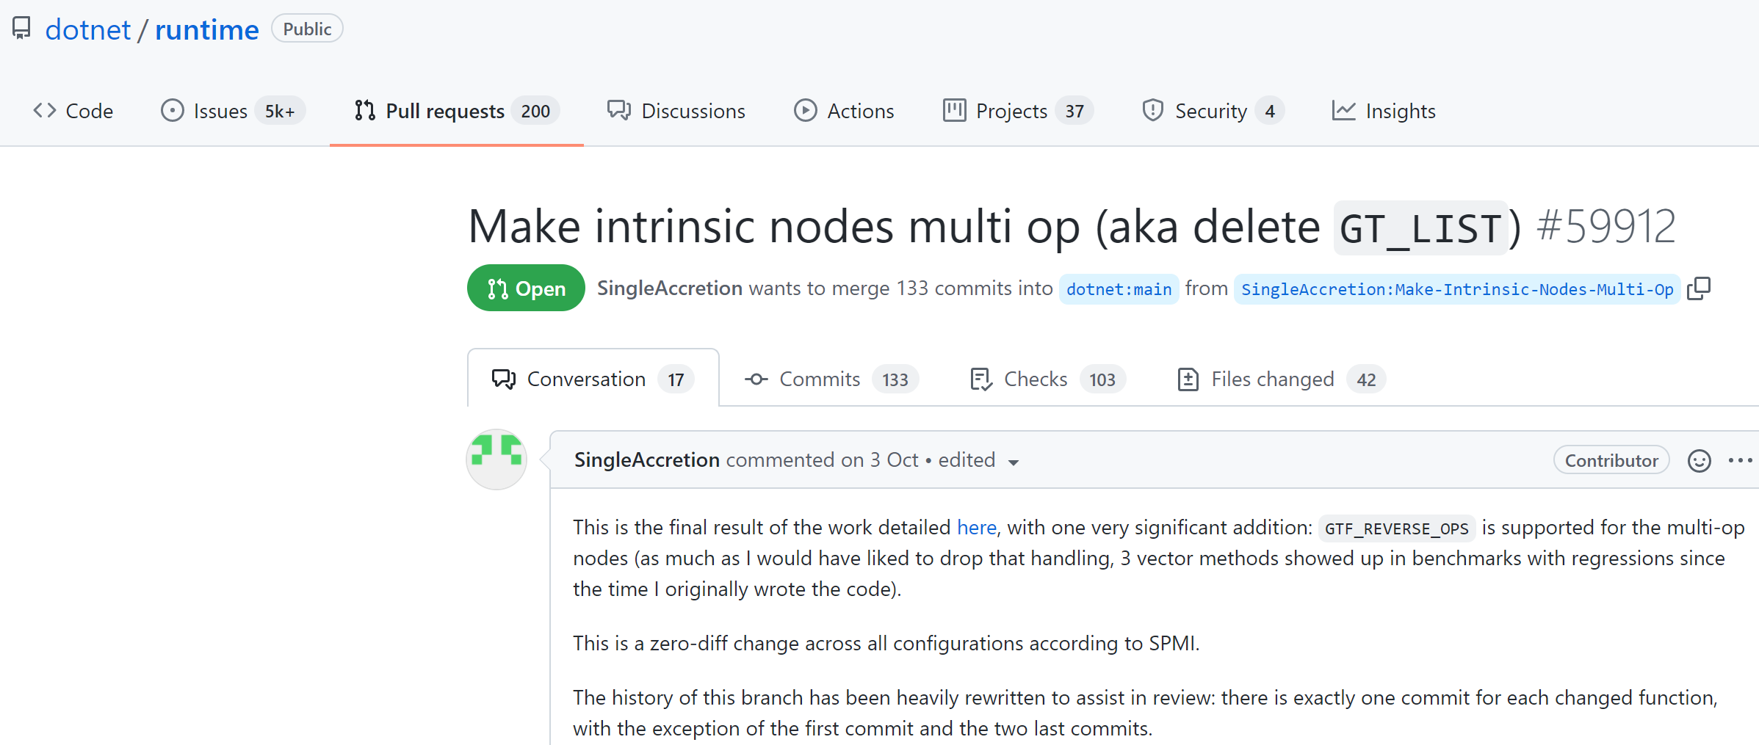
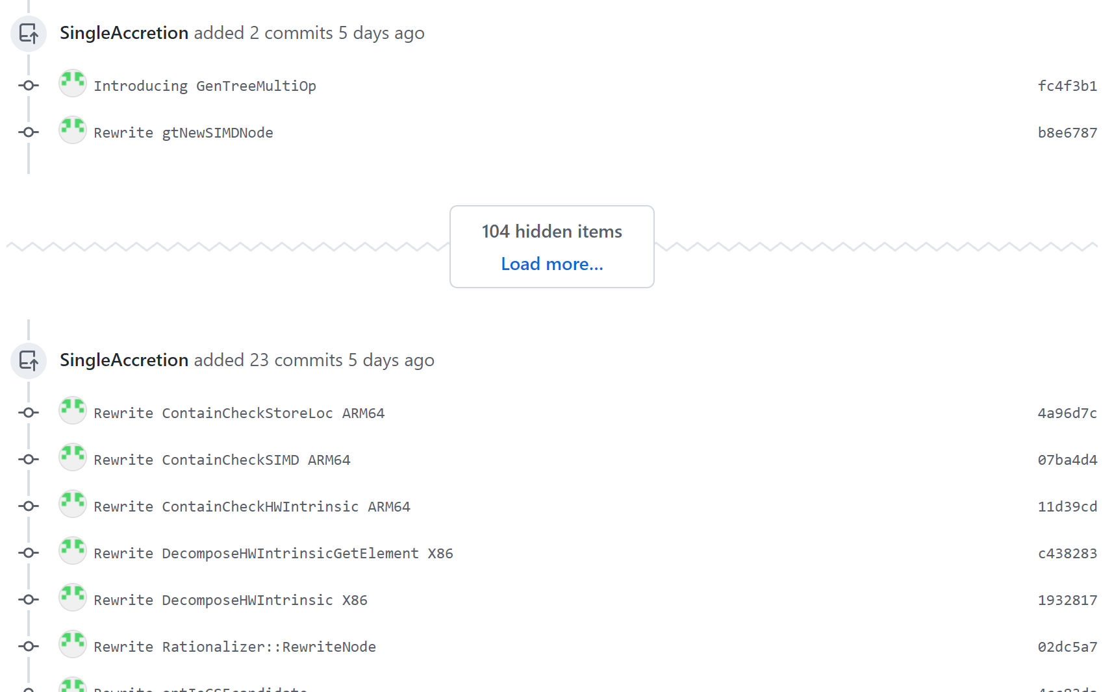
https://github.com/dotnet/runtime/pull/59912

Slide 84
Documenting for maintainers
Design decisions: what? why?

Slide 85
Avoid work
10 minutes now?
20 x 5 minutes later?

Slide 86
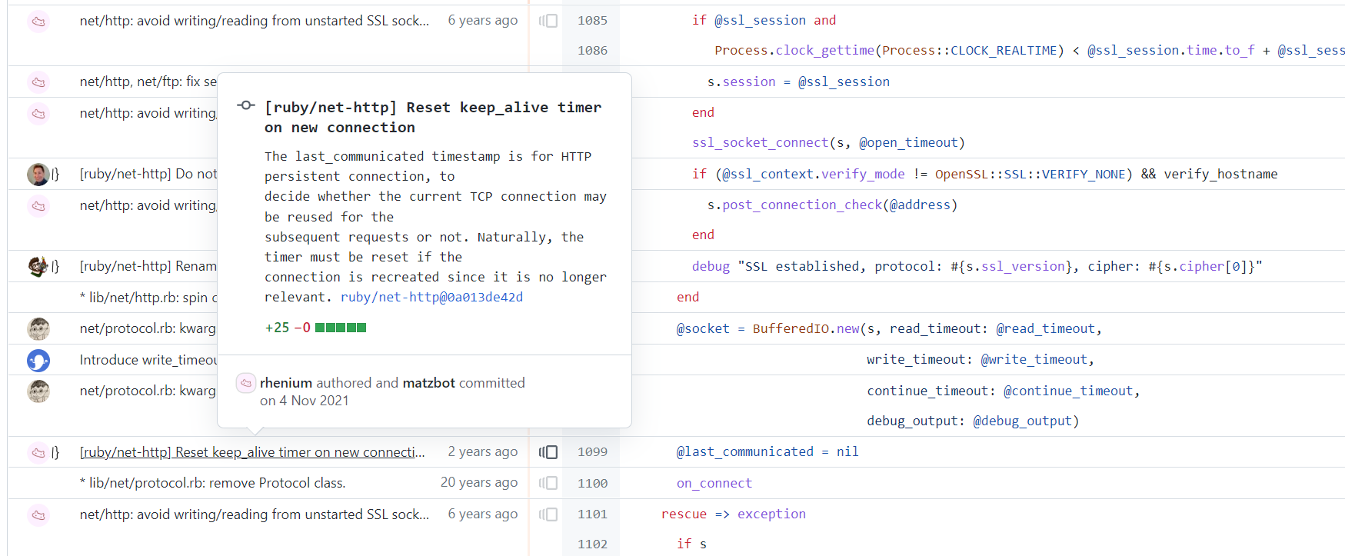
https://github.com/ruby/ruby/blame/master/lib/net/http.rb

Slide 87
“Architectural Decision Records”
Context
Decision
Consequences

Slide 88
Context
Requirements
Deadlines
Compatibility
…

Slide 89
“We must provide lecture notes.
We want to allow contributions from students.
…”

Slide 90
Decision
Alternatives
Arguments
Reasons
…

Slide 91
“We thought of PDFs, Google Docs, and GitHub.
PDFs are hard to contribute to.
…”

Slide 92
Consequences
Tasks
Changes
…

Slide 93
“We must migrate existing notes to GitHub.
We must convert them to Markdown.
…”

Slide 94
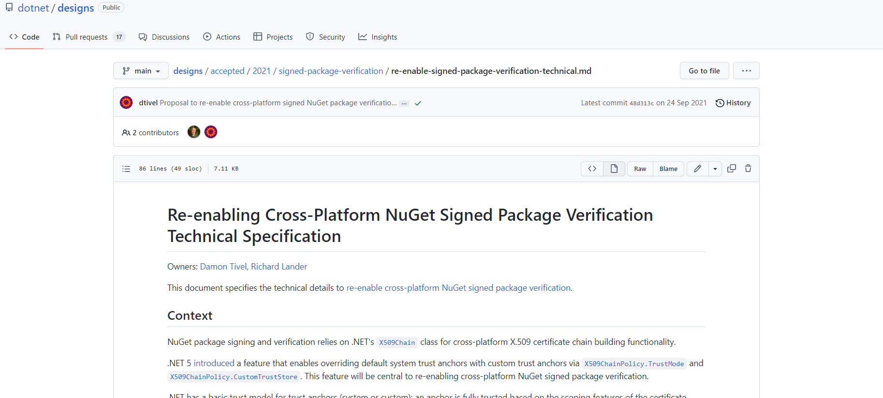
https://github.com/dotnet/designs/blob/main/accepted/2021/signed-package-verification/re-enable-signed-package-verification.md

Slide 95
ADRs
Documentation for important decisions
Kept close to code

Slide 96
How can we quantify changes?

Slide 97
Compatibility

Slide 98
Compatibility
Theory vs practice
Forward vs backward
Source vs binary

Slide 99
Theory vs practice
if (code != private_copy) crash();
if (add(1, 1) != 3) crash();

Slide 100


What’s your user base?

Slide 101
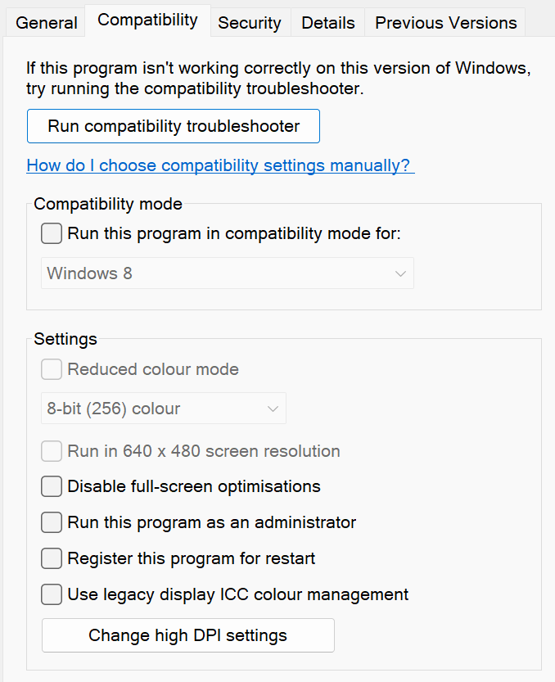
Extreme case
Windows 11

Slide 102
Forward compatibility
Version 1
Version 2

Slide 103
Backward compatibility
Version 1
Version 2

Slide 104
Forward and backward compat.
Forward
Backward
Client
Client
Old
Current
Next

Slide 105
Forward: don’t add anything
Backward: don’t remove anything

Slide 106
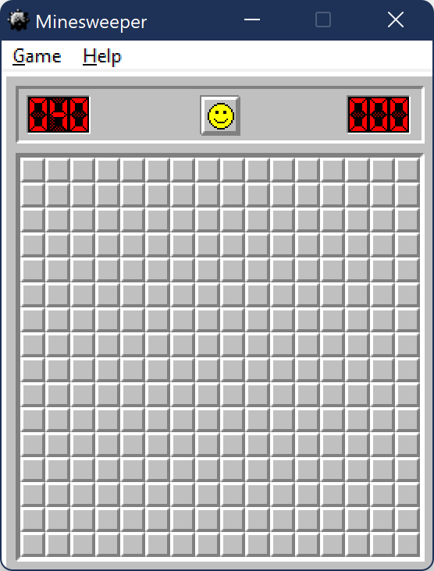
Win2000 Minesweeper, on Win11

Slide 107
Backward compat. in practice
What scenarios are supported?

Slide 108
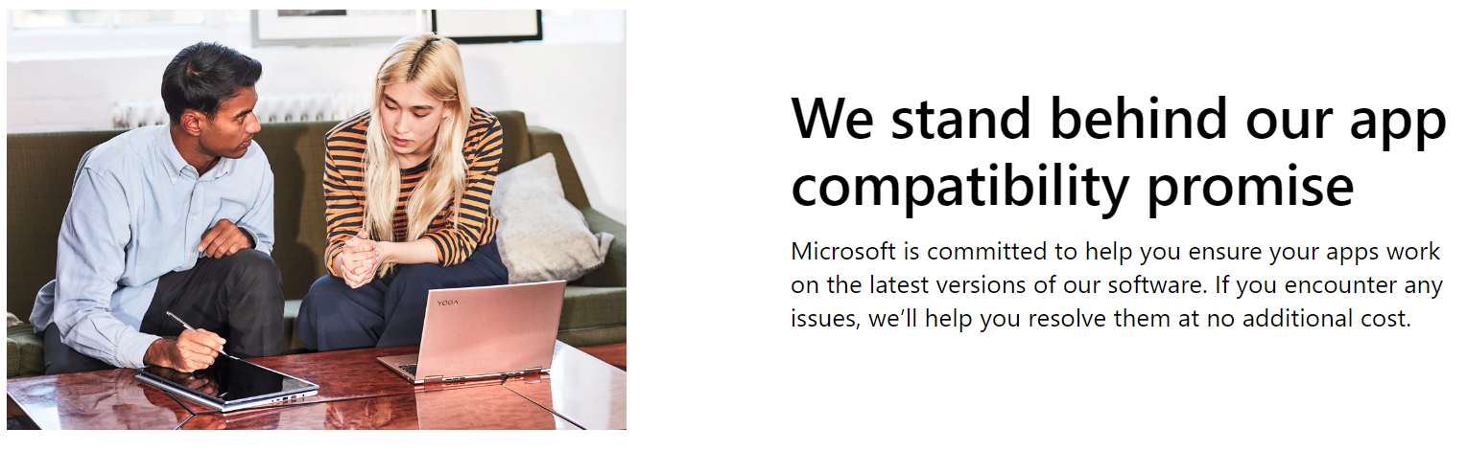
Extreme case
https://www.microsoft.com/en-us/fasttrack/microsoft-365/app-assure

Slide 109
SimCity and Windows 95
“…Microsoft tracked down the bug and added specific code to Windows 95 that looks for SimCity. If it finds SimCity running, it runs the memory allocator in a special mode that doesn’t free memory right away…”
https://www.joelonsoftware.com/2000/05/24/strategy-letter-ii-chicken-and-egg-problems/

Slide 110
Source compatibility
Integer n = sum(1, 2, 3);
static Integer sum(int... items);
int sum(Integer... items);

Slide 111
Binary compatibility
invokestatic sum([I)LInteger;
static Integer sum(int[] items);

Slide 112
Source: keep code compiling
Binary: keep binaries linking

Slide 113
“ABI”
“Application Binary Interface”
= API for compiled code

Slide 114
Preserving binary compatibility
Keep signatures intact
Method names, types, …

Slide 115
Example: source-only compat.
void Run(int a, int b = 0);
(C#)
C#

Slide 116
Example: binary-only compat.
Widget<X, Y>
(Java)

Slide 117
Is it backward compatible?
Add a class
Make a return type less specific
Make a return type more specific
Add a parameter
Make a parameter type less specific
Make a parameter type more specific

Slide 118
What compatibility to provide?
Depends on customers, feasibility, …
Error → success, typically OK
Success → error, not so much

Slide 119
How can we establish stable foundations?

Slide 120
Problem
import simplejson
...
NameError: name 'scanstring' is not defined

Slide 121
Versions
Named, tested, specific release
“Windows 11”
“simplejson 3.17.6”

Slide 122
Components
Major, minor
Patch, build
Name
Codename
…

Slide 123
Typical usage
Major = big change
Minor = small change
Rest = security patches, small fixes

Slide 124
“Semantic Versioning”
Major.Minor.Patch
Major = breaking change
Minor = new features
Patch = internal changes

Slide 125
“Breaking” is subjective

Slide 126
Using versions
Publish versioned releases
Deprecate if necessary
Consume versions of dependencies

Slide 127
Publishing versions
Support?
Compatibility?
Compatibility with others?
...

Slide 128
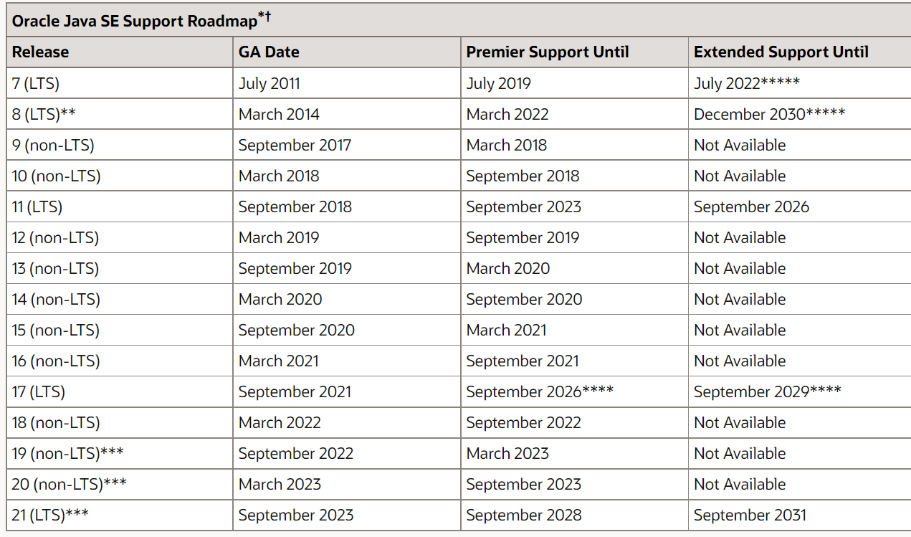
Example
https://www.oracle.com/java/technologies/java-se-support-roadmap.html

Slide 129
In practice
v1.0
v2.0
Main

Slide 130
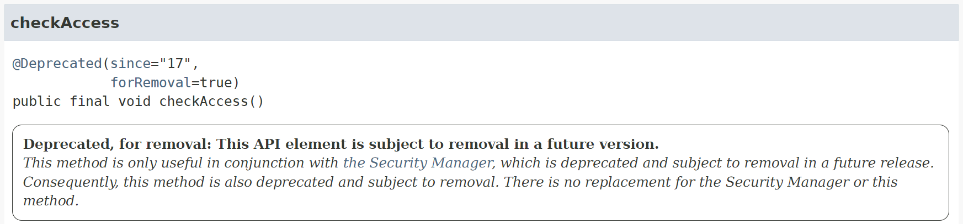
“Breaking” exceptions

Slide 131
>>> from collections import Iterable
DeprecationWarning: Using or importing the ABCs from 'collections' instead of from 'collections.abc' is deprecated since Python 3.3, and in 3.10 it will stop working

Slide 132
Deprecating
@Deprecated(...) (Java)
[Obsolete(...)] (C#)
warnings.warn(...) (Python)

Slide 133
Deprecating?

Slide 134
Consuming versions
List “known good” versions

Slide 135
In practice
testImplementation 'org.junit.jupiter:junit-jupiter-api:5.9.1'

Slide 136
Beware of wildcards
testImplementation 'org.junit.jupiter:junit-jupiter-api:5.+'

Slide 137
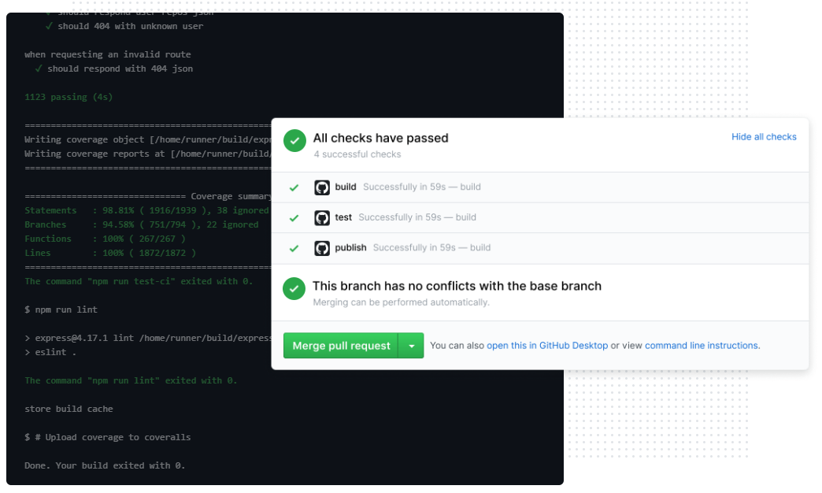
Versioning entire machines
VMs, containers
https://github.com/features/actions

Slide 138
Beware…
bool DoesDriverSupport(ID capability);
https://devblogs.microsoft.com/oldnewthing/20040211-00/?p=40663

Slide 139
Summary
Evolving legacy code: goals, refactorings, documentation
Dealing with large codebases: learning as you go, incremental improvements
Quantifying and qualifying changes: compatibility, versioning

